Slide 1
Project 1: MTA Data
Samantha Rood, Zaw Aung, Maria Scott

Slide 2
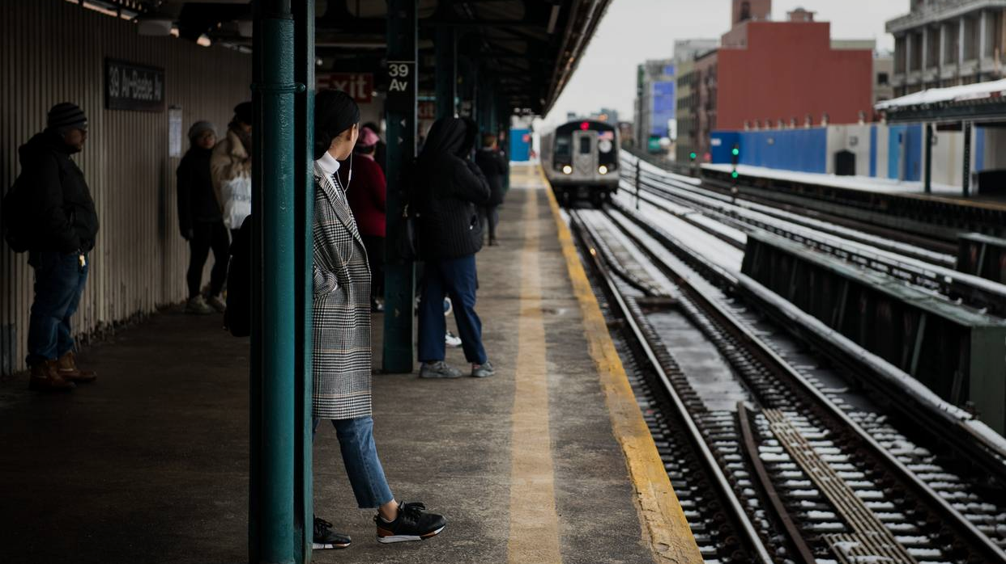


Using the data available from NY MTA we have found how to optimally place volunteers for WTWY at stations
We wanted to place volunteers to gain sign ups from commuters at MTA stations
Notes:
Introduction:
Thank you WomenTechWomenYes for the opportunity to be part of such a worthy cause.
We have done extensive analysis of freely available subway traffic information
And have some valuable recommendations for deploying volunteers to attract high potential membership candidates to your annual gala.
Our methodology
was to consider , first the timing of the gala itself,
then the target audience in relation to station locations and traffic volume.

Slide 3
Methodology
MTA Turnstile Data (May 2019)
Metrics including time of the day, day of the week, and ridership
Consider locations relative to each other
Cross-reference check with average values published by MTA
Notes:
Data: Used the month of may to be close to the event time for maximum impact
Used freely available MTA data to calculate traffic per station
Validated traffic against other freely available traffic sources
Stations: Wanted to ensure we had high volume station to reach max amount of people while avoiding tourists
Cap maximum number of people that can go through turnstile per hour.

Slide 4
Results

Slide 5
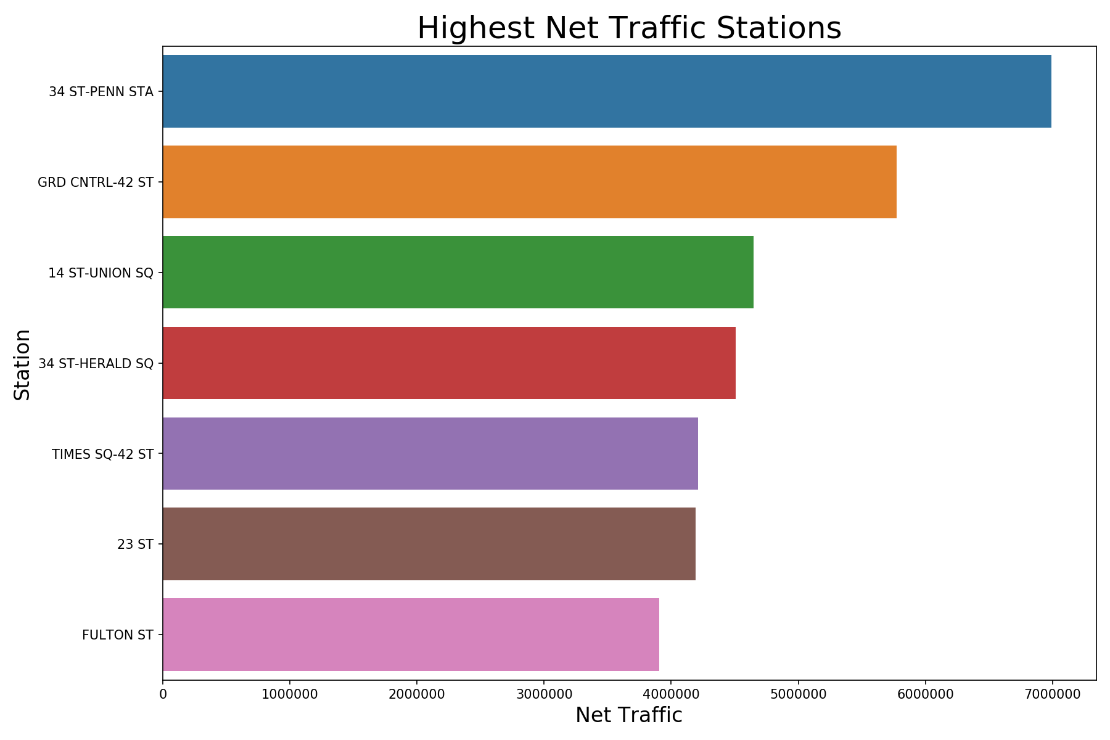

Slide 6
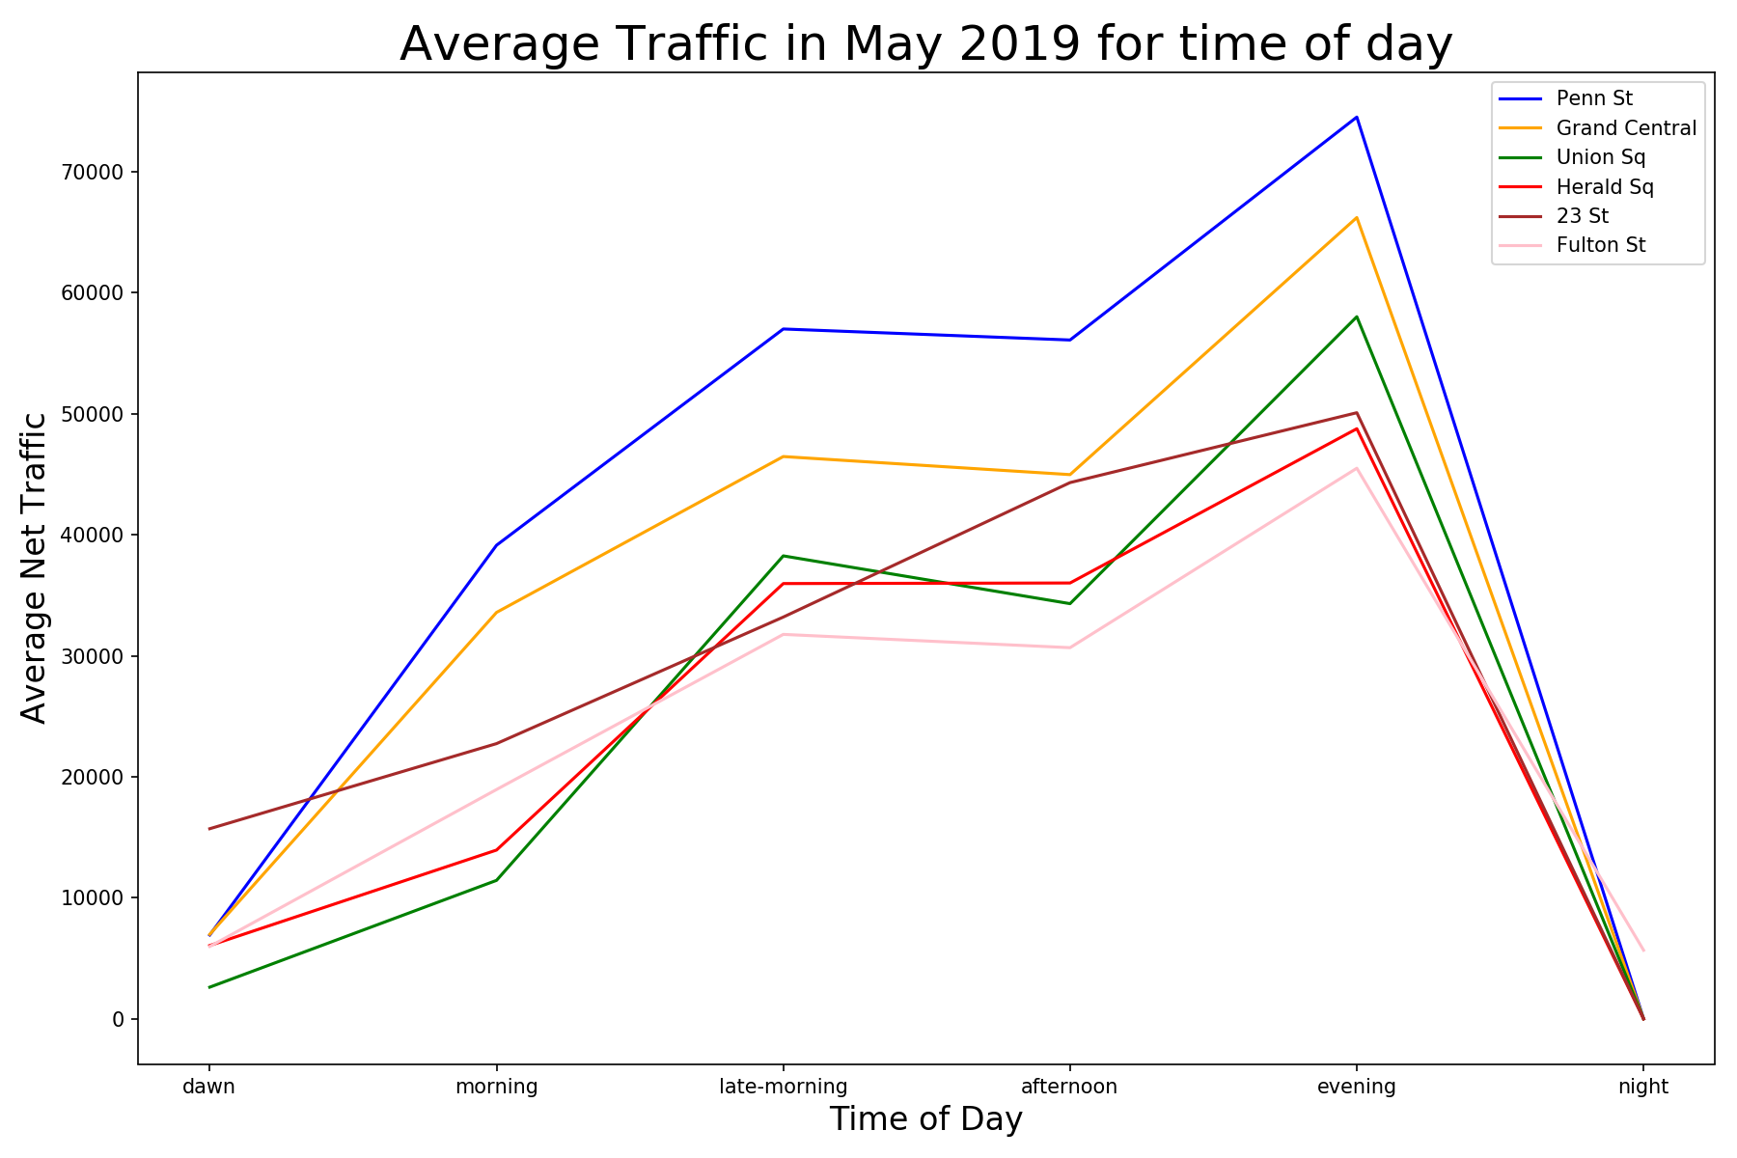
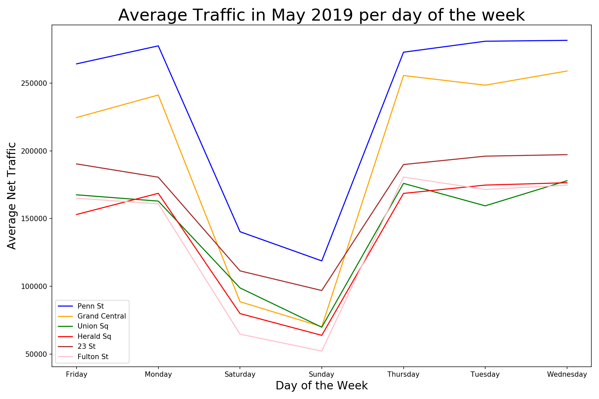

Slide 7
Conclusion
Top 6 stations: Penn St, Grand Central, Herald Sq, 23st, Union St, Fulton St
Top days: Monday, Tuesday, Wednesday, Thursday
Top Times: Late-morning, afternoon, evenings
Stations are within 1 mile radius, except Fulton station.
Notes:
1 slide

Slide 8
STATION | DAYS | TIME FRAMES
Penn Station | Monday - Thursday | Late Morning, Afternoon, & Evening
Grand Central | Monday - Thursday | Late Morning, Afternoon, & Evening
Union Station | Monday - Thursday | Late Morning, Afternoon, & Evening
Herald Square | Monday - Thursday | Late Morning, Afternoon, & Evening
23rd Street | Monday - Thursday | Late Morning, Afternoon, & Evening
Fulton Street | Monday - Thursday | Late Morning, Afternoon, & Evening
Notes:
Targeting high volume stations but at times when people are receptive, midday and evening v. morning.
Lower volume on weekends, but more receptive audience could have higher conversion rate

Slide 9
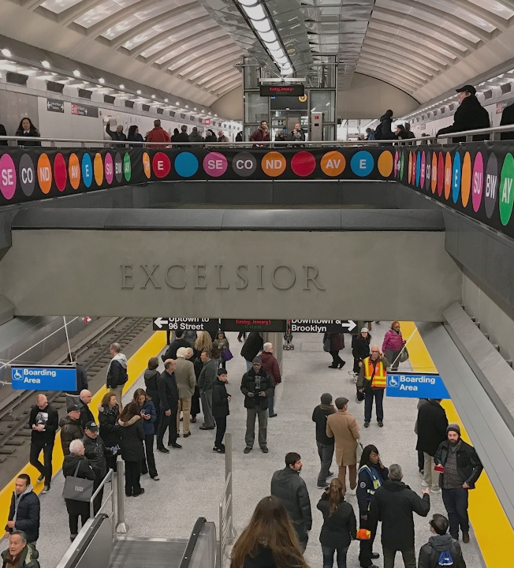
Future work:
More research on the different station
Deeper looking into the patterns of past years
Propose backup stations that are near top stations
Look into seeing if volunteers are able to ride the subway to get signatures

Slide 10
Appendix

Slide 11
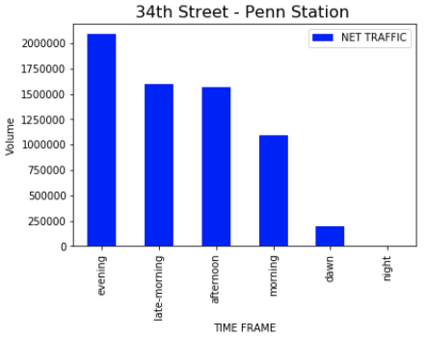
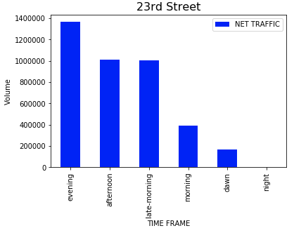
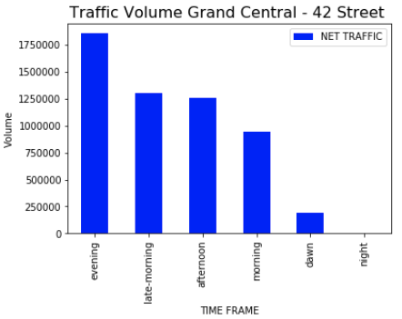
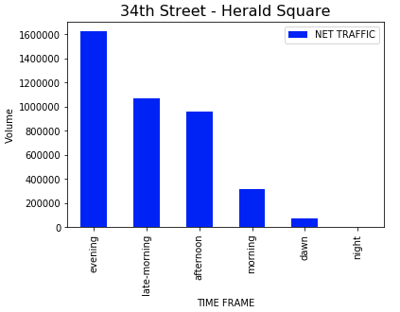
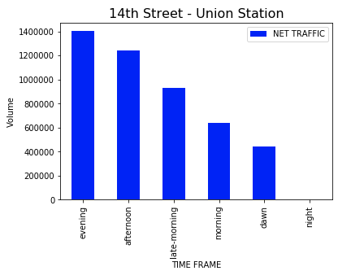
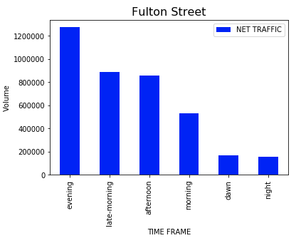

Slide 12
TIME FRAME | HOURS
Dawn | 0-5
Morning | 6-9
Late-morning | 10-13
Afternoon | 14-17
Evening | 18-21
Night | 22-24

Slide 13
